Slide 1
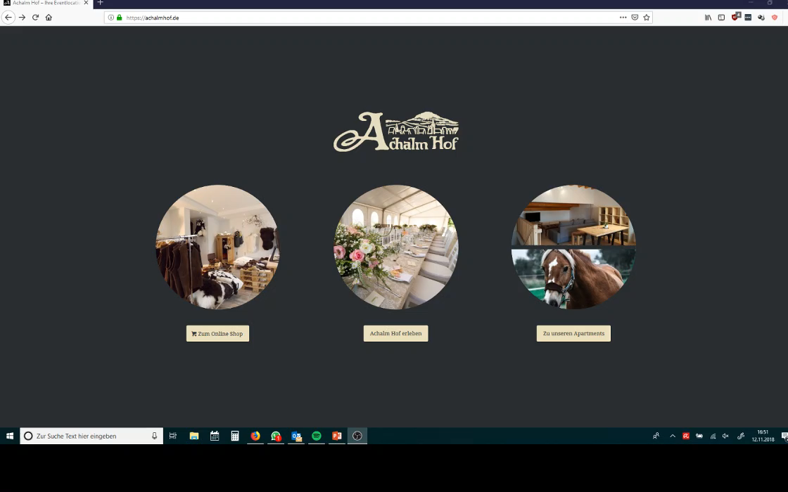
Potential Customer can find us on Google or other Portals
PC visit our Website and have a look around
1
2
PC find the Contactdoc. Look there
3.1
3

Slide 2
4
PC send us an inquiry
5
We receive the request and confirm it, PC receives a link.
The link leads to our customer portal
6
7
In this portal, only a calender with possible introductory dates is displayed in the first step. The link leads to our customer portal
8
PC is looking for an appointment

Slide 3
9
10
After the introductory appointment, the PC will gain access to the extended customer portal
Access to the extended customer portal is valid for 7 days, during which PC must have registered
Extended customer portal includes „must haves“, which must be completed and confirmed by us to come to the „nice to have“
11
12
PC gets reminders for deadline compliance on the app.

Slide 4
Nice to have = special services
Special services are offers from us and from service providers we work with.
Service providers can present themselves, e.g. with an image video etc.

Slide 5
Task:
- Creation of the website on CMS basis
Creating an app for the customer and for us. This allows the customer in his cutomer portal
Store Customer data for newsletter and reminder
Preparation of customer portal
Very simple and attractive presentation.
Website should be the center of communication between Achalm Hof and PC.

